Slide 1

Akrivia Health / Global Minds Proteomics Update
Julie Segueni, PhD, Bioinformatics
Kevin Blighe, PhD, Bioinformatics
Corey Oravetz, CSM, Project Manager​
Shahraz Niwaz, MSc , Business Account Manager
2026-May-05

Slide 2
Agenda
Action Items
Bio Updates
Open Q&A / Discussion
Timeline / Gantt
Month 2026
00

Slide 3
Meeting Minutes & Action Items

Slide 4
Meeting Minutes
Action Item Review
Corey: Walked the team through the Completed items from 2 weeks ago, the In Progress items that Julie will be sharing today, and several open items on the JnJ side.
Joe: Confirmed that they have been unsuccessful with find the prior analysis and there hasn't been any further development in some areas, but the team would discuss several of these items later in the meeting.
Updates
Julie: Reviewed the PCA plots for the NULISA dataset showed no clear diagnosis-based clusters, even after merging CNS and inflammation panels and removing dementia patients.
Julie: The variance partitioning confirmed age and sex as covariates, but adjusting for them risks removing true biological signal, since psychotic disorder patients are significantly younger than other cohorts.
Julie: The unadjusted DA analysis identified proteins in bipolar disorder (2), depressive disorder (0), schizophrenic disorder (0), and psychotic disorder (9, including 8 downregulated). No log-fold change threshold was applied.
Joe: Highlighted a striking contrast with the Somascan results, where depression showed a large number of DA proteins but other diseases did not. This is opposite of what the NULISA dataset shows.
Julie: Reviewed the pathway enrichment results per disease: bipolar showed chemotaxis and metabolic upregulation along with defense response to fungus. The depressive disorder showed downregulated leucocyte migration, epithelial differentiation and response to fungus. The psychotic disorder showed upregulated interferon pathways and schizophrenic disorder showed downregulated neurotransmitter and monoamine transport.

Slide 5
Meeting Minutes
Updates (cont.)
Erin: Raised a concern that inflammatory proteins appeared under the monoatomic ion transport pathway in the master dot plot, suggesting a possible pathway-gene alignment issue. She asked Julie to do some additional verification of this alignment to confirm.
Julie: Reviewed the age/sex adjustment which eliminated all DA proteins entirely. This possibly points to an over-adjustment and/or the unadjusted analysis was considered more appropriate to retain biological signal.
Joe: Questioned the utility of a ML prediction model given the small sample size and limited DA proteins, and suggested clustering may be more appropriate than supervised prediction.
Julie: Discussed some patient related self-reported diagnoses vs. EHR-based diagnosis as a reliability concern. Some patients had mixed/double reported diagnoses (e.g., bipolar + depression) and these could be removed to further help with the diagnostic ambiguous patients (~5 out of ~450).
Joe: Suggested this was small enough that it might not have as much of an impact as needed to see any difference.
Julie: Shared that the clinical data could add a lot of granularity and might help inform on covariates and of areas not yet considered, such as removing the effect of a drug, looking at patients that are in remission or, in the case of depressive disorder, diagnosis that might not last the patients entire life.
Joe: Commented that Lisa's analysis does not have a large number of scores, but the team can do some brainstorming around drugs or other clinical aspects to look at if their initial plan doesn't work out.
Julie: Confirmed that there was enough data to do the clustering with Joe agreeing to try this approach.

Slide 6
Meeting Minutes
Updates (cont.)
Erin: Asked about use of the UKBB data as an external reference to validate gene-level differences across bipolar, schizophrenia, and depression
Joe: Shared that UKBB is Olink-based data and while this could be an interesting analysis, he suggested discussing offline.
Kevin: Noted existing slides from work with Chris Whelan covering schizophrenia, bipolar, Alzheimer's, and MDD using a trans-diagnostic panel approach. He offered to share results with the group.
Ricardo: Reported to the team on his work around the SNP enrichment signal in cases within the Akrivia dataset (~896 patients with genotyping data) where he plans to stratify by diagnosis and explore further with clinical data, noting that ~250 patients overlap with the proteomics dataset.
Erin: Asked about racial background of the Akrivia dataset
Richardo: Shared that the patients are ~80–90% Caucasian and confirmed allele frequencies used were European-based. But noted individual-level ancestry analysis could be possible once he's able to dig into the data further.

Slide 7
Action Items
Action Items from 2026-May-05 Meeting
Julie: Check that the pathways are correctly aligned with the associated genes (specifically monoatomic ion transport). - IN PROGRESS
Julie: Conduct some color coding to show what proteins come from the Inflammation vs CNS panel and confirm the positive regulation of monoatomic ion transport. - IN PROGRESS
Julie: Finalize the adjusted vs non-adjusted comparison and compare effect sizes between the Somascan and NULISA datasets. - IN PROGRESS
Julie: Perform ML clustering analysis merging the Somalogic and NULISA datasets with dementia patients removed. - IN PROGRESS
Kevin: Share slides from the Chris Whelan UKBB trans-diagnostic panel analysis done previously. - IN PROGRESS
Joe: Discuss offline with Erin the use of the UKBB as an external dataset for comparison. - IN PROGRESS
FYI – Julie pursuing different presentation material to comply with Conference Deadlines – Now Rancho specific

Slide 8
Action Items
Action Items from 2026-Mar-31 Meeting
Julie: Start analysis of new dataset and compare Somalogic dataset to NULISA dataset - IN PROGRESS (Slides Today)
Julie: Proposed building a diagnostic prediction model using proteomic features to classify patients by disease – IN PROGRESS
Joe: Follow up with Kris Rhodes and others in JnJ about prior analysis files. - IN PROGRESS
Farzad: Discuss with Lisa on plan for clinical data analysis. - IN PROGRESS
Joe: Presentation of dataset and analysis plan (NULISA) - IN PROGRESS
Action Items from 2026-Mar-17 Meeting
Joe: Circle back and confirm that sharing subject IDs from the Akrivia database without other associated data is approved by the broader group. - IN PROGRESS
Action Items from 2026-Feb-10 Meeting
Joe: Provide Julie with any details about the normalization process that was applied to one of the data files - IN PROGRESS
Joe: Check on the progress of clinical data analysis and share any relevant co-morbidities or self-reported information that might be useful for differential analysis in next week's meeting – IN PROGRESS

Slide 9
Bio Updates

Slide 10
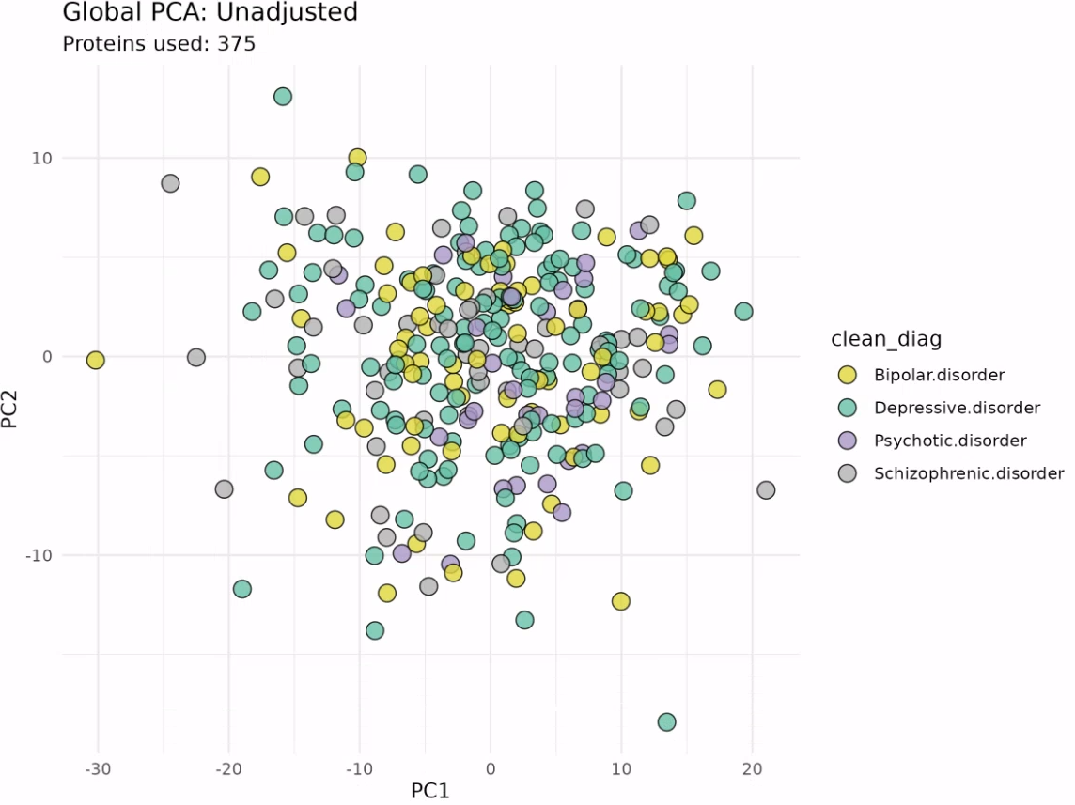
Overview of the NULISA dataset (unadjusted)
Merged both CNS and Inflammation panels before analysis
Removed Dementia patients
No clear disease-specific PCA cluster using the NULISA dataset

Slide 11
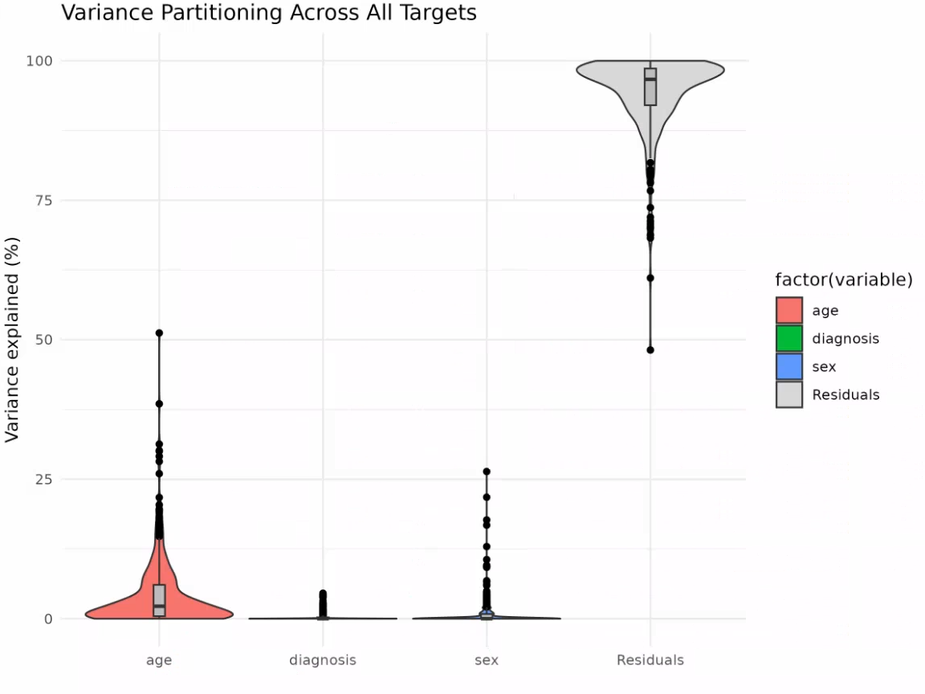
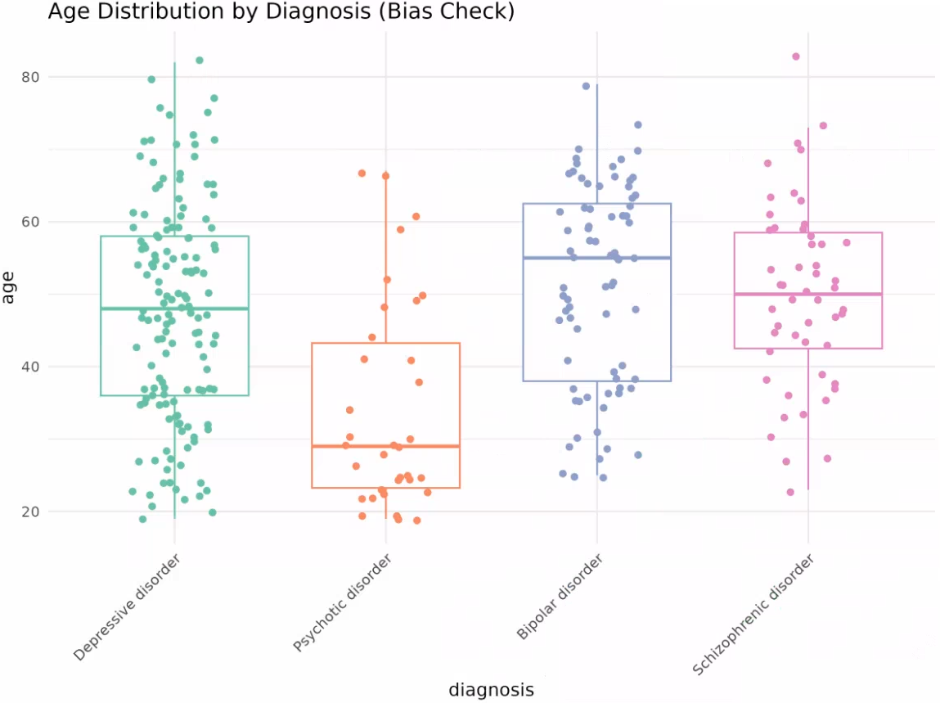
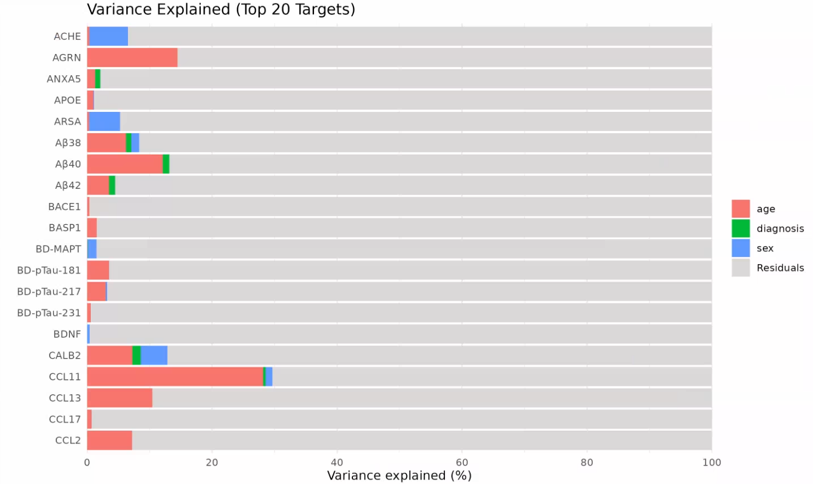
Variance Partitioning Analysis of the data to identify covariates
Age (and sex) could be considered as a viable covariate in our NULISA dataset analysis, given we have removed the Dementia patients
However, Psychotic disorder patients are significantly younger than the rest of our disease groups and correcting for age could remove true biological difference

Slide 12
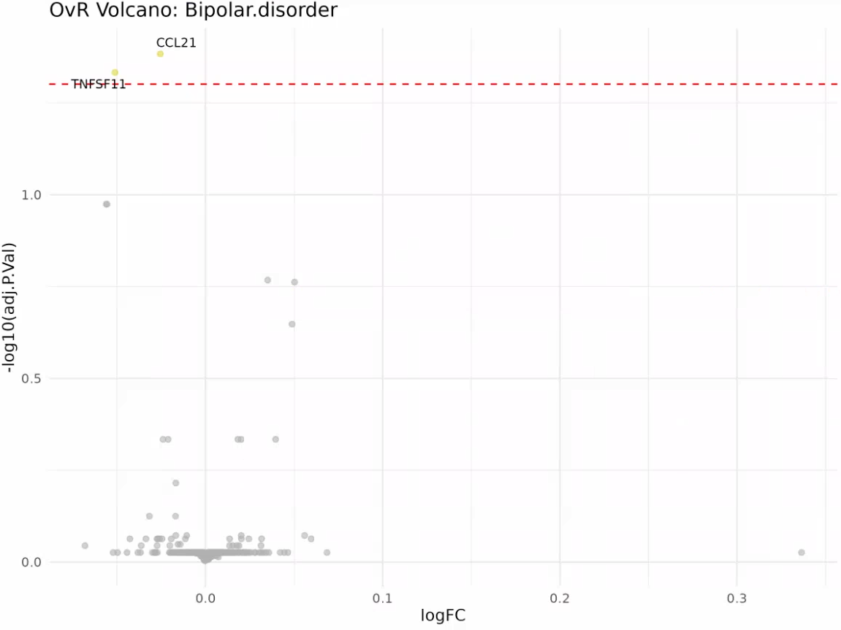
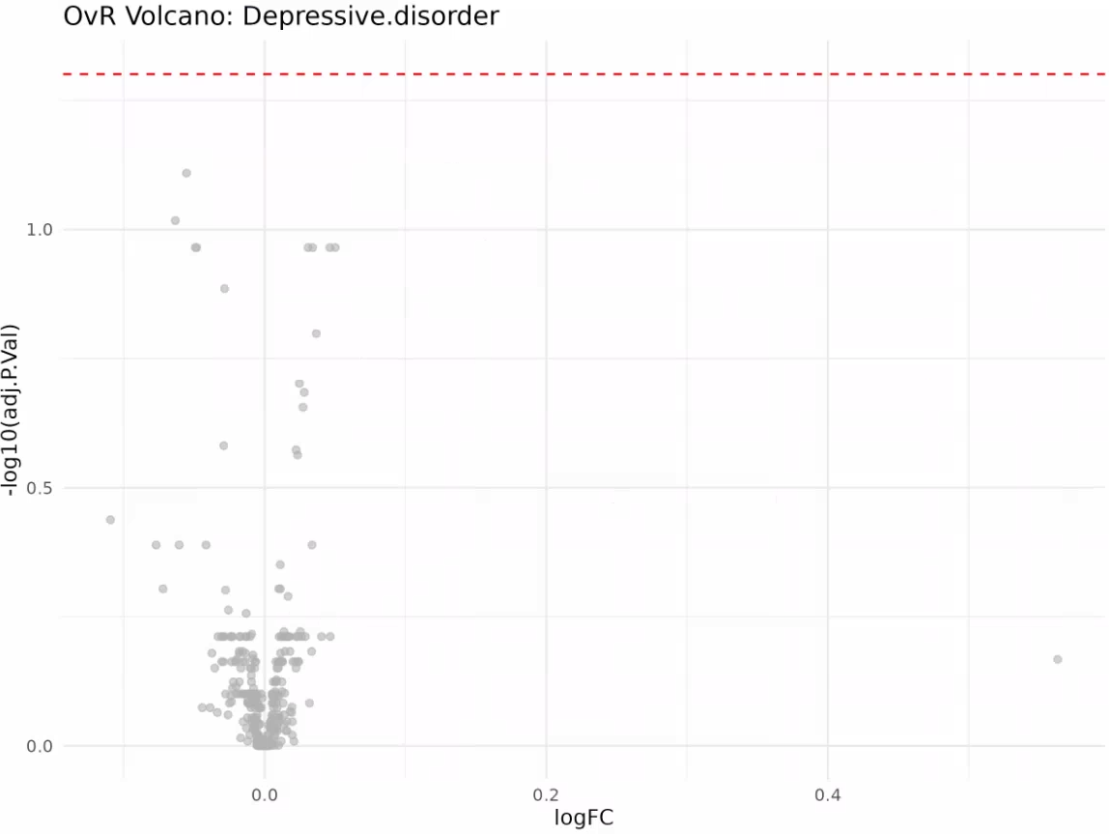
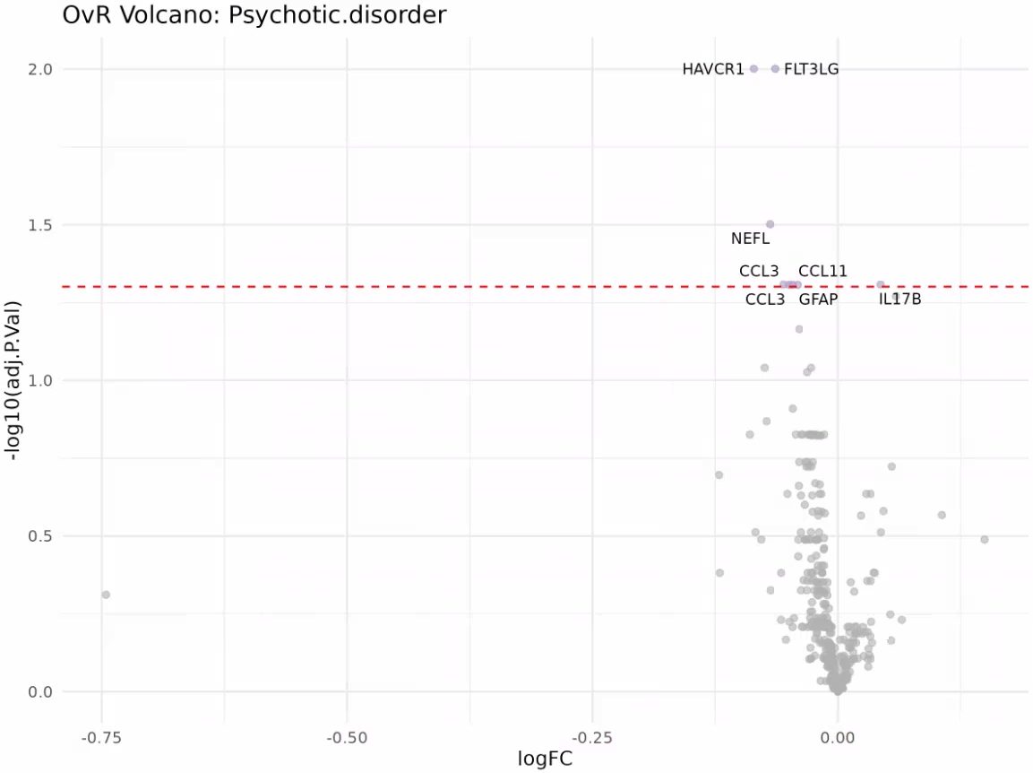
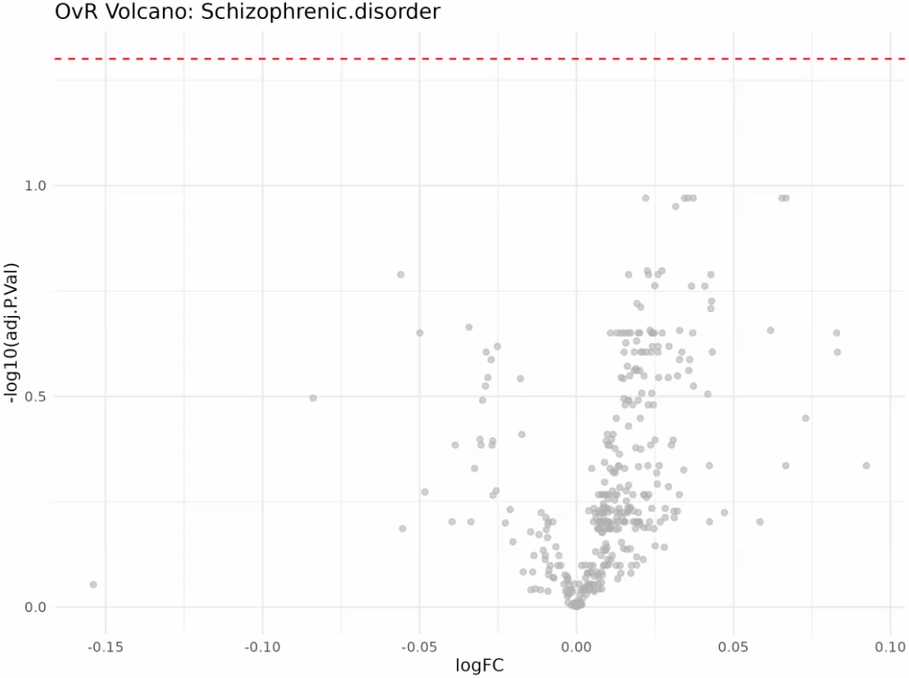
DA results on the NULISA dataset (unadjusted)
2 DA proteins (downregulated) for Bipolar disorder vs the rest: CCL21 and TNFSF11
0 DA protein for Depressive disorder vs the rest
9 DA proteins (8 downregulated, 1 upregulated) for Psychotic disorder vs the rest: IL17B (up), FLT3LG, HAVCR1, NEFL, CCL3, GFAP, CCL11
0 DA protein for Schizophrenic disorder vs the rest

Slide 13
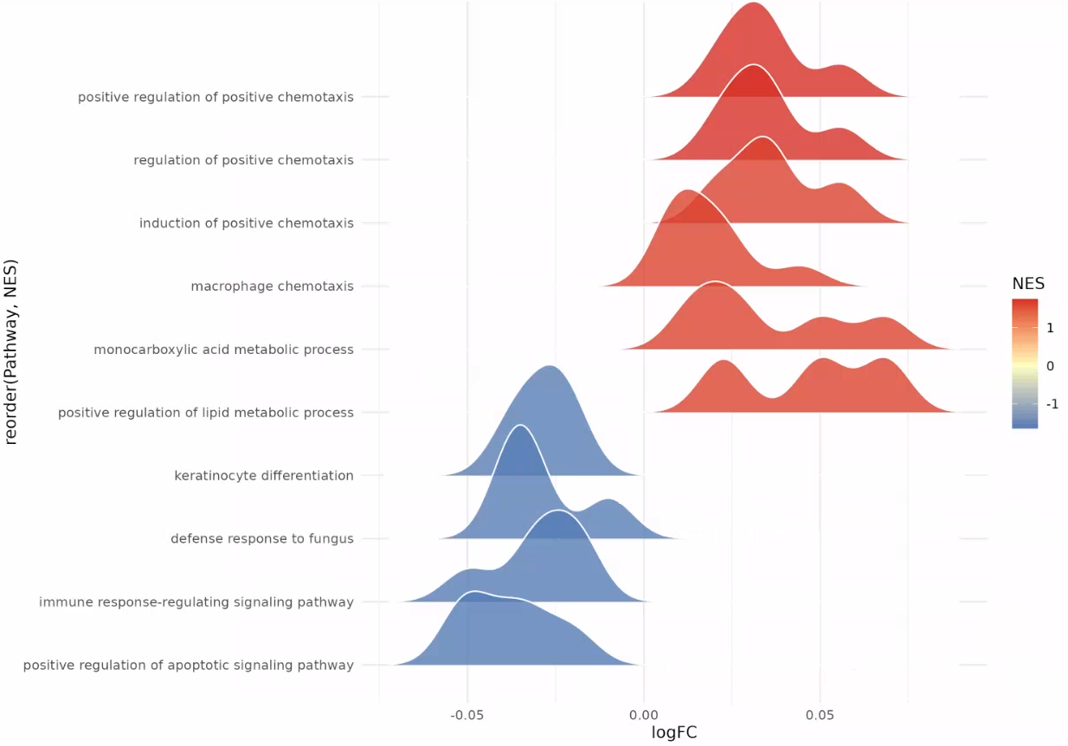
Pathway results on the NULISA dataset (unadjusted) – Bipolar disorder
2 DA proteins (downregulated) for Bipolar disorder vs the rest: CCL21 and TNFSF11
0 DA protein for Depressive disorder vs the rest
9 DA proteins (8 downregulated, 1 upregulated) for Psychotic disorder vs the rest: IL17B (up), FLT3LG, HAVCR1, NEFL, CCL3, GFAP, CCL11
0 DA protein for Schizophrenic disorder vs the rest

Slide 14
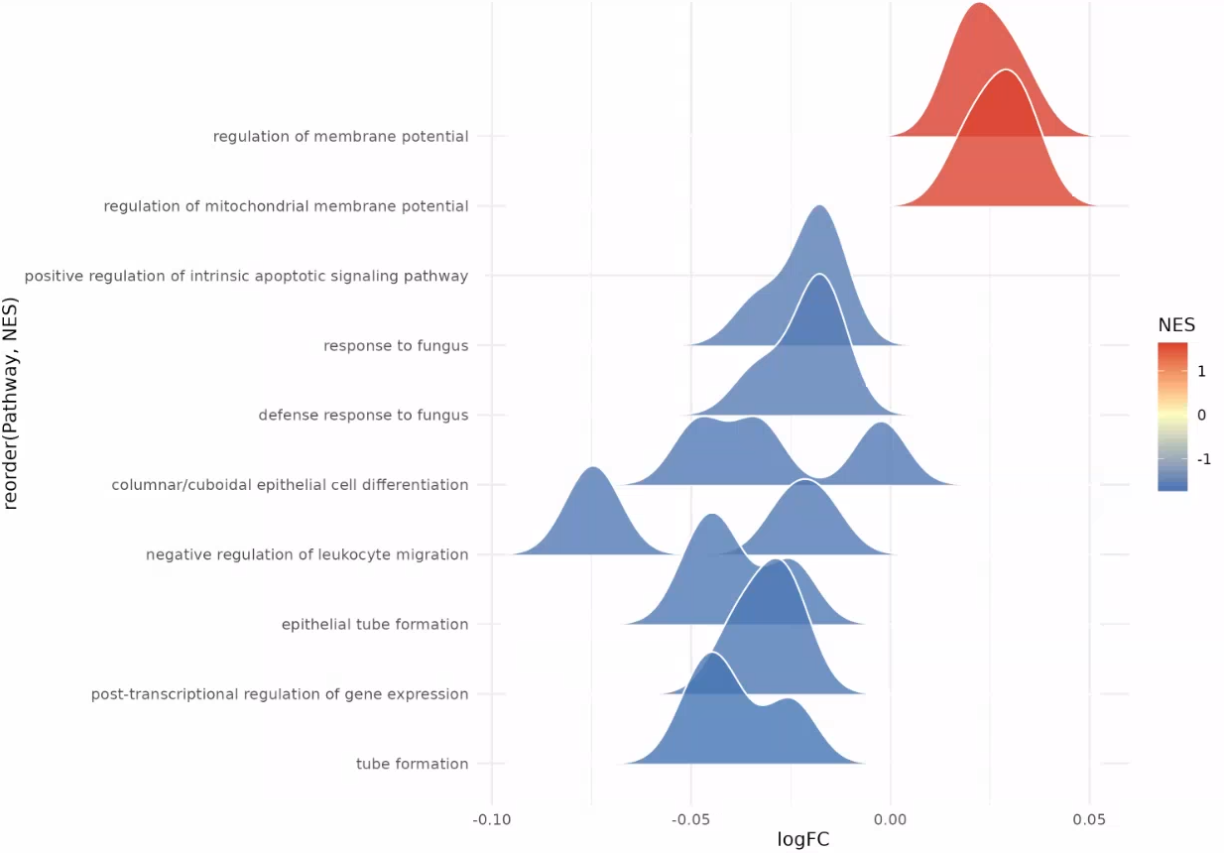
Pathway results on the NULISA dataset (unadjusted) – Depressive disorder
2 DA proteins (downregulated) for Bipolar disorder vs the rest: CCL21 and TNFSF11
0 DA protein for Depressive disorder vs the rest
9 DA proteins (8 downregulated, 1 upregulated) for Psychotic disorder vs the rest: IL17B (up), FLT3LG, HAVCR1, NEFL, CCL3, GFAP, CCL11
0 DA protein for Schizophrenic disorder vs the rest

Slide 15
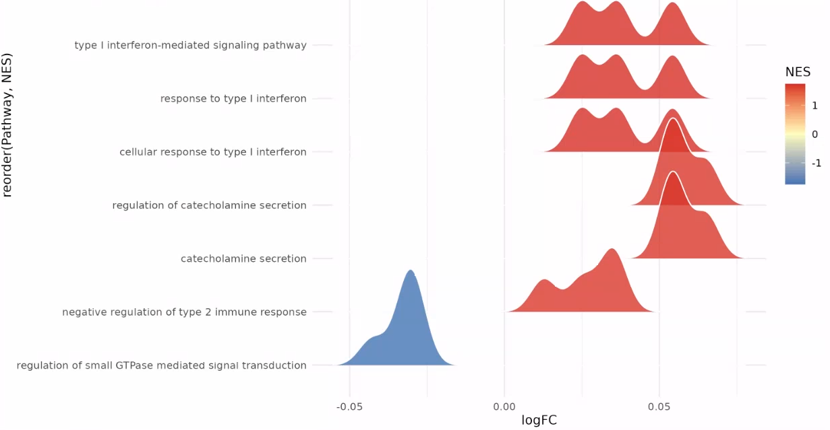
Pathway results on the NULISA dataset (unadjusted) – Psychotic disorder
2 DA proteins (downregulated) for Bipolar disorder vs the rest: CCL21 and TNFSF11
0 DA protein for Depressive disorder vs the rest
9 DA proteins (8 downregulated, 1 upregulated) for Psychotic disorder vs the rest: IL17B (up), FLT3LG, HAVCR1, NEFL, CCL3, GFAP, CCL11
0 DA protein for Schizophrenic disorder vs the rest

Slide 16
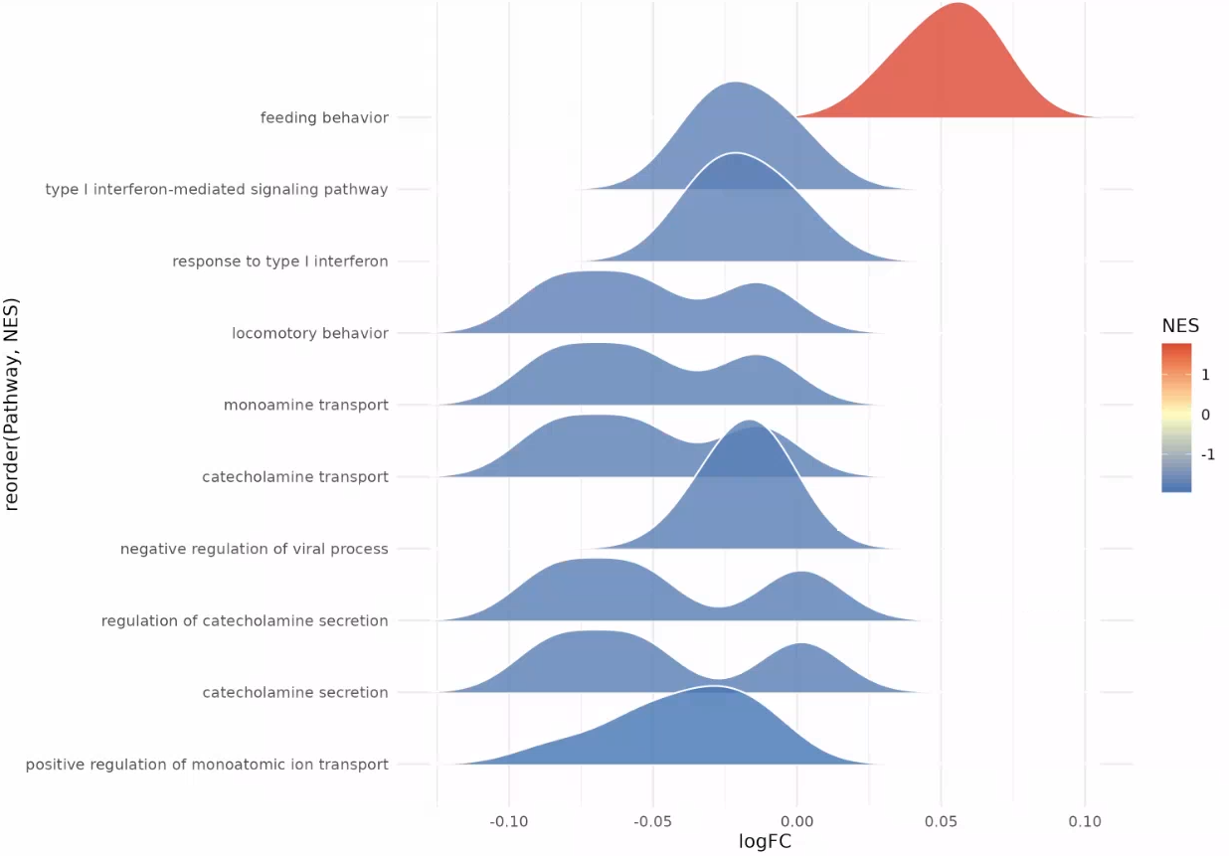
Pathway results on the NULISA dataset (unadjusted) –Schizophrenic disorder
2 DA proteins (downregulated) for Bipolar disorder vs the rest: CCL21 and TNFSF11
0 DA protein for Depressive disorder vs the rest
9 DA proteins (8 downregulated, 1 upregulated) for Psychotic disorder vs the rest: IL17B (up), FLT3LG, HAVCR1, NEFL, CCL3, GFAP, CCL11
0 DA protein for Schizophrenic disorder vs the rest

Slide 17
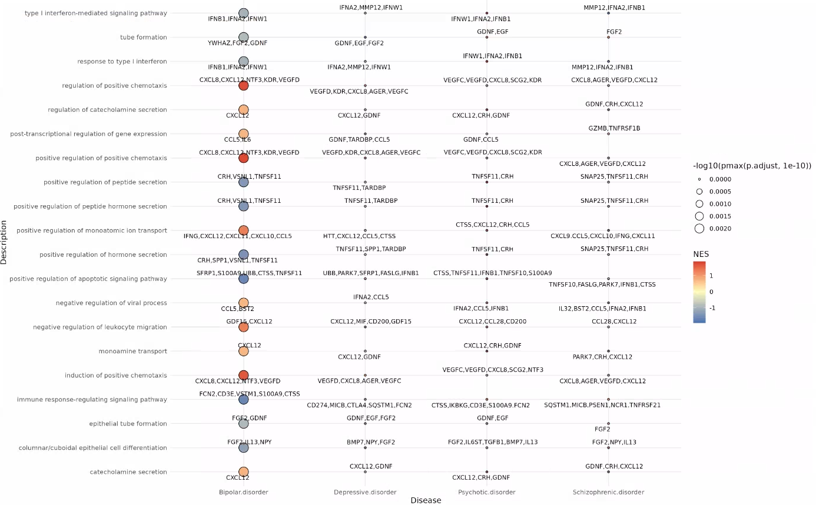
Pathway results on the NULISA dataset (unadjusted)

Slide 18
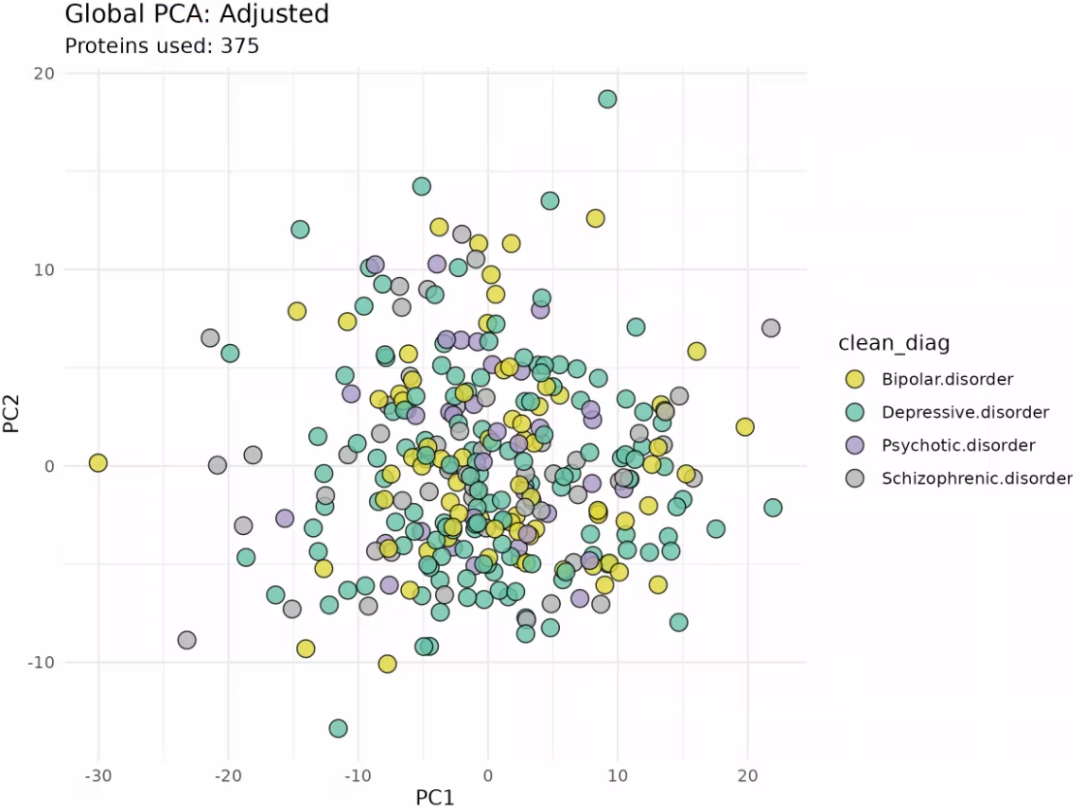
Overview of the NULISA dataset (adjusted for age and sex)
Merged both CNS and Inflammation panels before analysis
Removed Dementia patients
No clear disease-specific PCA cluster using the NULISA dataset

Slide 19
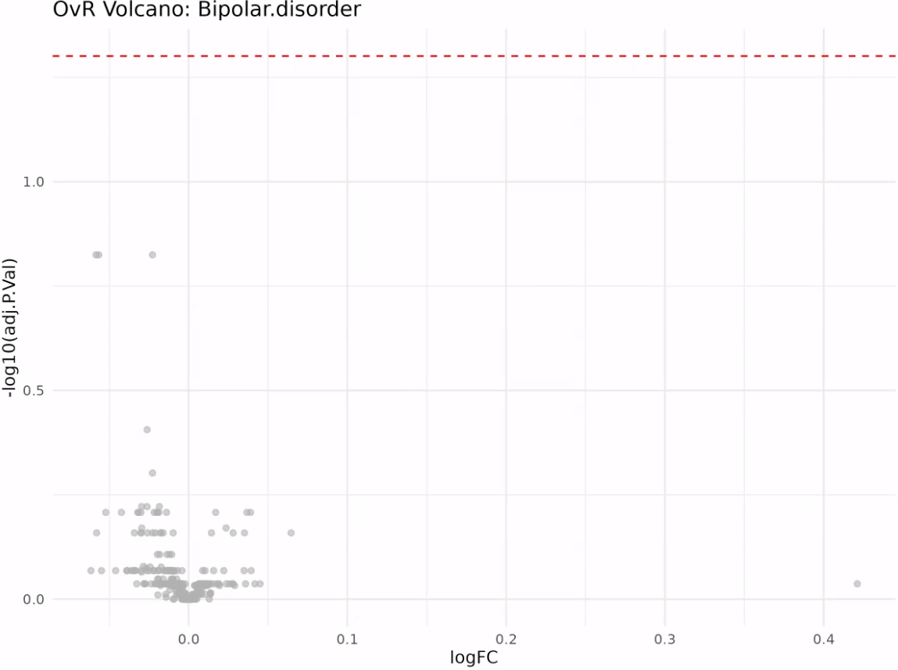
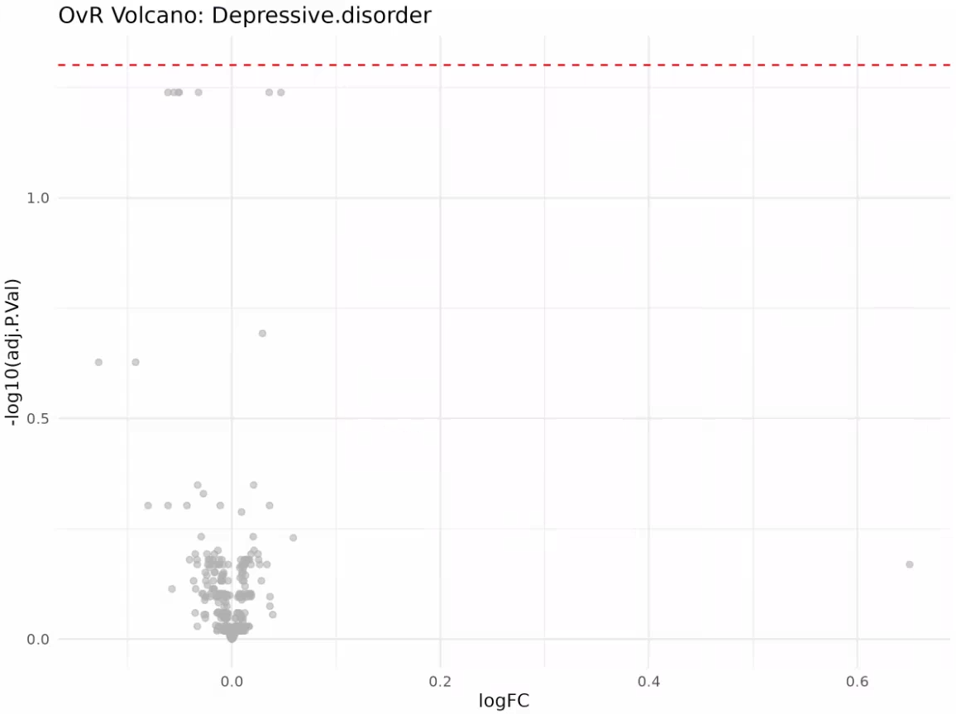
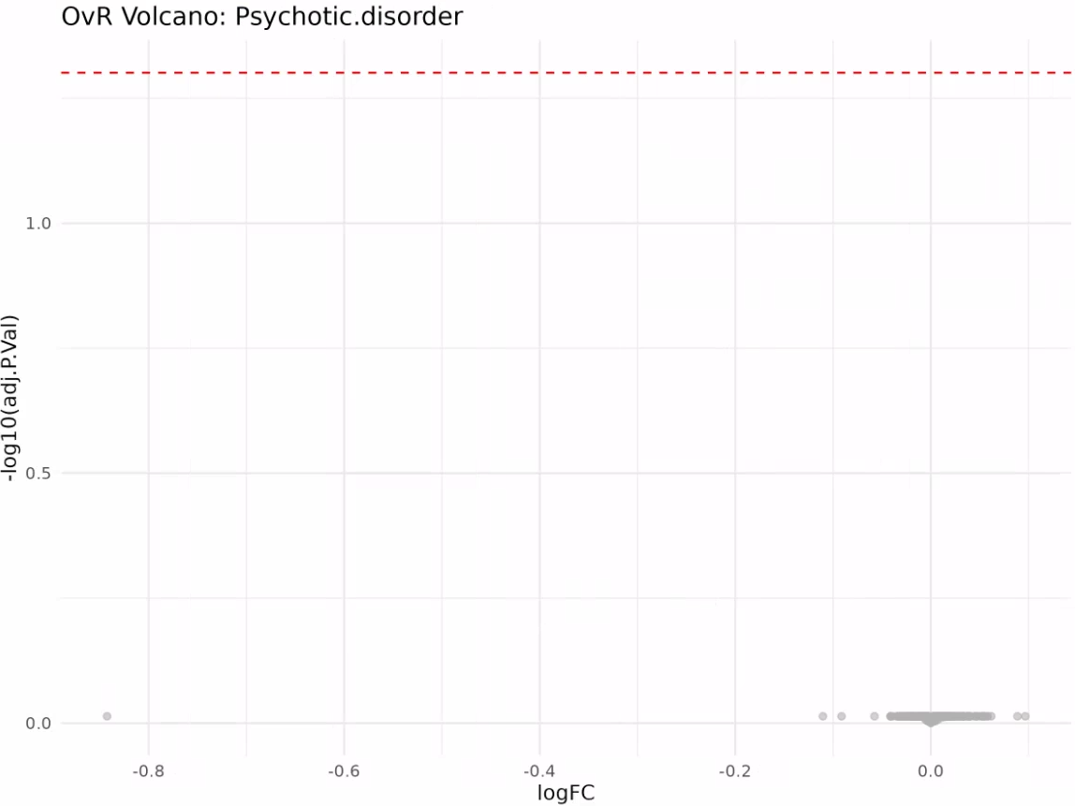
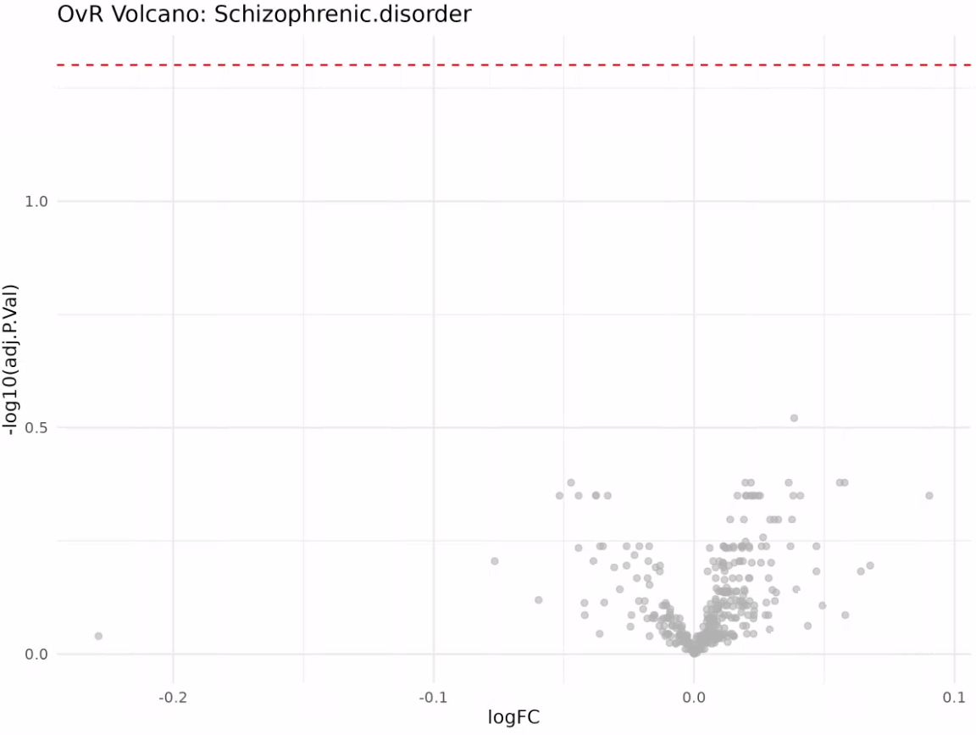
DA results on the NULISA dataset (adjusted)
0 DA proteins identified after age + sex adjustment

Slide 20
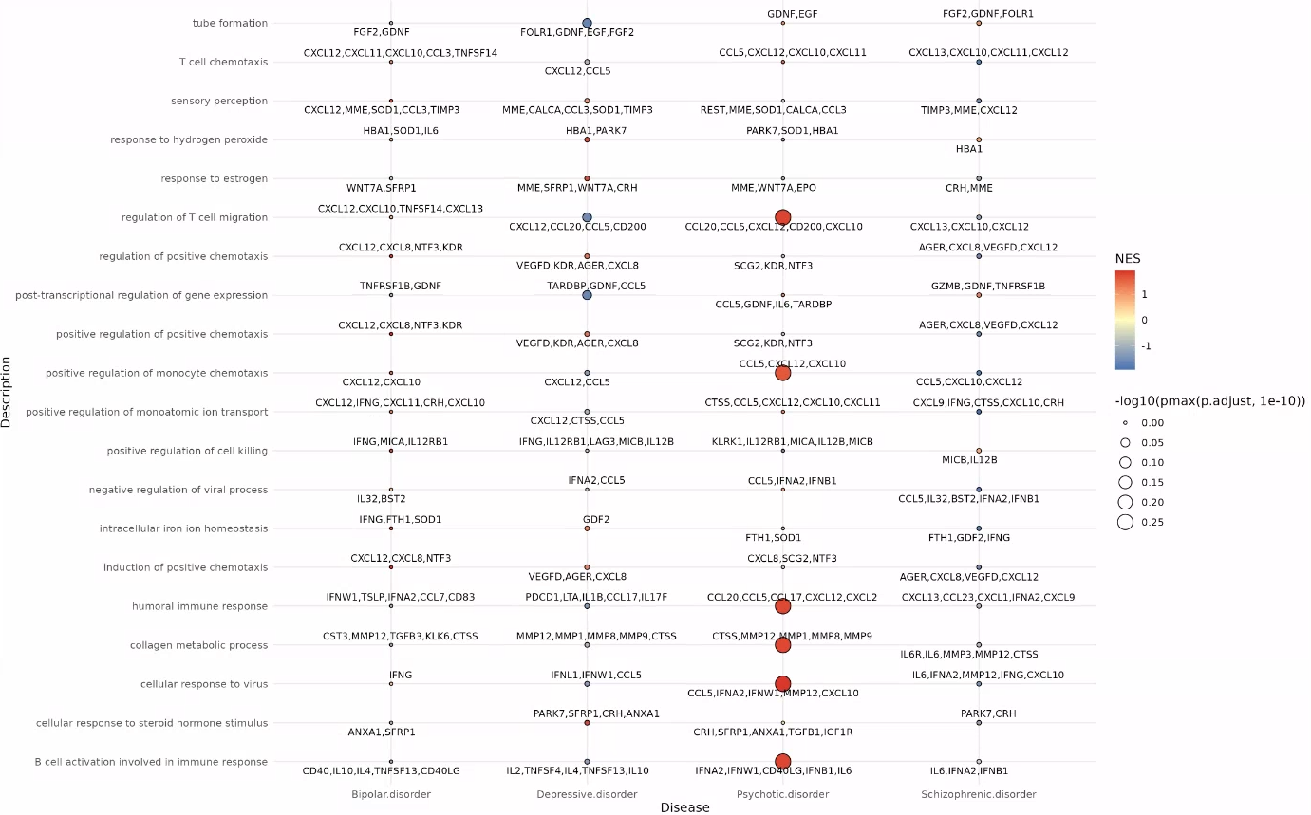
Pathway results on the NULISA dataset (adjusted)
Pathway also found in unadjusted pathway analysis master dotplot

Slide 21
Next Steps, Timelines, Further Analysis
What should be our next steps? Recommendations:
Finalize SomaLogic and NULISA dataset comparison
Finalize machine learning models using merged dataset for each patient
Use SYNGO database for neuro-specific ontologies as proposed by Ricardo
Expected timelines?
When to expect Clinical Data access/export and availability for analysis?

Slide 22
Timeline & Deliverables

Slide 23
J&J: Akrivia Health SomaLogic Proteomics Analysis
Timeline
Today
2026
Feb
Mar
Apr
May
Jun
Feb 3 - Feb 9
5 days
Onboarding, Environment Setup, Data Import into Domino
2026
Feb 10 - Feb 13
4 days
Data Normalization & QC
Feb 16 - Feb 23
6 days
Diff Abundance Analysis (DAA)
Global Minds / Akrivia Proteomics Analysis
Pathway Analysis + Variance Partitioning Analysis, Removing Dementia Patients, ML, NULISA
Feb 24 - May 11
55 days
May 12 - May 25
Compare Treatment-Resistant Patients vs Responders
10 days
Correlate Proteomics Levels to Clinical Data
10 days
May 26 - Jun 8
Jun 9 - Jun 10
2 days
Reporting & QC
Timeline
On-Boarding (4 hours)
Data Retrieval, Normalization, & QC (16 hours)
Differential Abundance Analysis (DAA) (24 hours)
Pathway Analysis (24 hours)
Compare treatment-resistant patients vs responders (16 hours)
Correlate proteomics levels to clinical data (12 hours)
Reporting & QC (8 hours)
Total: 104 hours Bioinformatics; 10 hours Project Management.

Slide 24
Archive

Slide 25
Action Items
Action Items from 2026-Mar-31 Meeting
Julie: Review and identify common overlapping signatures and pathways between diseases. - COMPLETED
Julie: Complete upset diagram plot showing common DA proteins across diseases. - COMPLETED
Julie: Perform analysis removing dementia and focusing on the four neuropsychiatric disorders. - COMPLETED
Julie/Corey: Send the slides to the team after the meeting. - COMPLETED, 2026-Mar-31

Slide 26
Action Items
Action Items from 2026-Mar-17 Meeting
Julie: Ask Kevin about age correction in the previous analysis and obtain the relevant slides - Julie: Create protein abundance heat maps for proteins within enriched pathways from the rich plots. - COMPLETED (NO ACCESS TO FILES OR CODE)
Julie: Create a heat map showing average protein expression per diagnosis (bipolar disorder, dementia, depressive disorder, psychotic disorder) for the DA proteins. - COMPLETED
Action Items from 2026-Mar-10 Meeting
Julie: Extract proteins within the ridge plot peaks and plot them on raw abundance heatmaps. - COMPLETED

Slide 27
Action Items
Action Items from 2026-Mar-10 Meeting
Julie: Redo DA analysis and Pathway analysis using Age as covariate – COMPLETED, 2026-Mar-17
Julie: Color the volcano plot by identified pathway membership to show distribution of effect sizes per pathway. - COMPLETED, 2026-Mar-17
Julie: Provide new plots showing raw pathway-level abundances using dementia as a reference group across all diseases. - COMPLETED, 2026-Mar-17
Joe: Check-in with Alessandra that the budget and spend are acceptable if the project timeline extends. - COMPLETED, 2026-Mar-17
Action Items from 2026-Feb-24 Meeting
Julie: Pathway analysis from DAA results – COMPLETED, 2026-Mar-09
Action Items from 2026-Mar-17 Meeting
Julie: Julie to consider further analysis during the DAA that can statistically validate the absence of bias effects - COMPLETED, 2026-Mar-17
Julie: Start on the DAA process – COMPLETED, 2026-Feb-23
Action Items from 2026-Feb-10 Meeting
Joe: Joe to reach out to Akrivia to get clarification about the 17 samples labeled as 'other' - COMPLETED, 2026-Mar-17
Julie: Start on the QC and normalization process – COMPLETED, 2026-Feb-13

Slide 28
Action Items
Action Items from 2026-Feb-03 Meeting
Joe: Provide access to the MS Teams folder with the clinical XLS files – COMPLETED, 2026-Feb-06
Farzad: Create a new Domino project and upload the proteomics data files for the analysis – COMPLETED, 2026-Feb-03
Corey: Setup weekly calendar cadence for the team to meet – COMPLETE, 2026-Feb-03

